Slide 1

YELP A Review Analysis

Slide 2

A bit of Domain Knowledge on yelp
Pros:
Democratic Review Process
Overall Honest
Thousands of very, very, wordy, reviews
Cons:
No Filter
No Guidance
No Context

Slide 3
How Restaurants Intersect with Yelp
Most Restaurants are satisfied with a 4-star rating
3.5 is a motivator for change
Any restaurant over 100 reviews cannot maintain 5 stars
By 300 reviews your rating will settle, thus 3-star restaurants typically stay 3-stars.
Because there’s no reliable rubric, individual ratings swing from 1-star or 5-star, with few in between.
This leaves most restaurants settling in the 4 zone.
Truly amazing restaurants get 4.5s

Slide 4
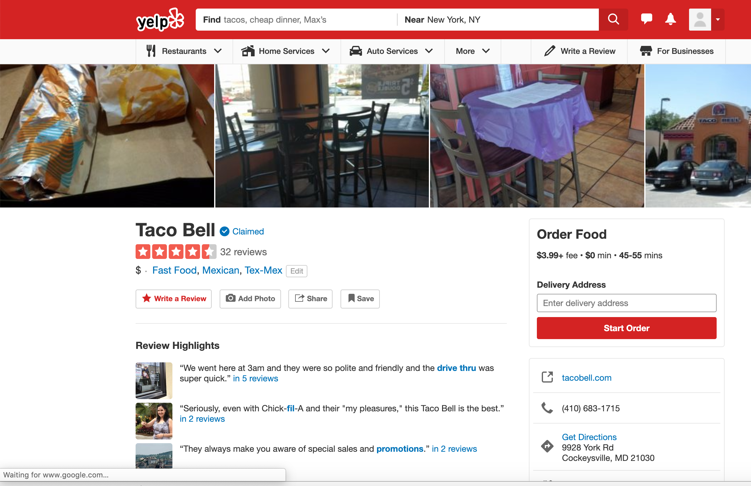
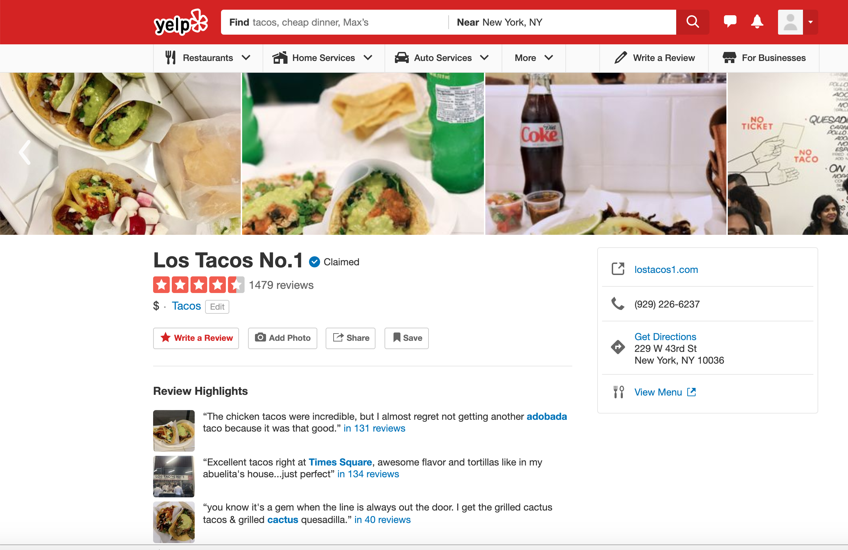


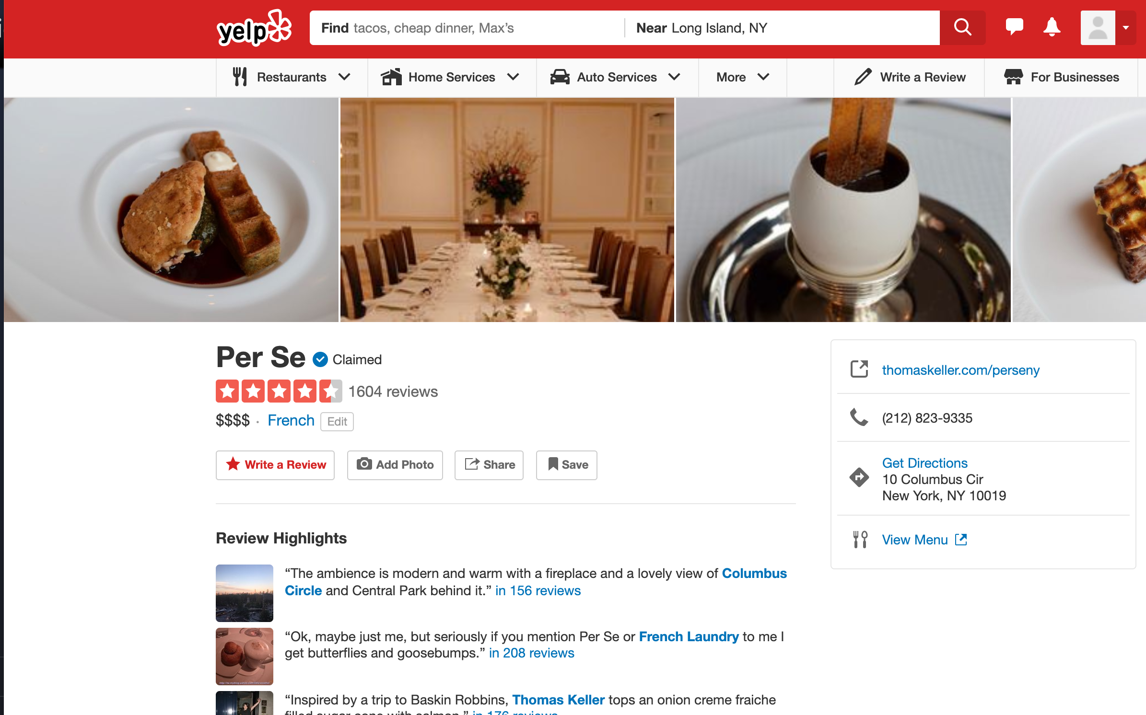
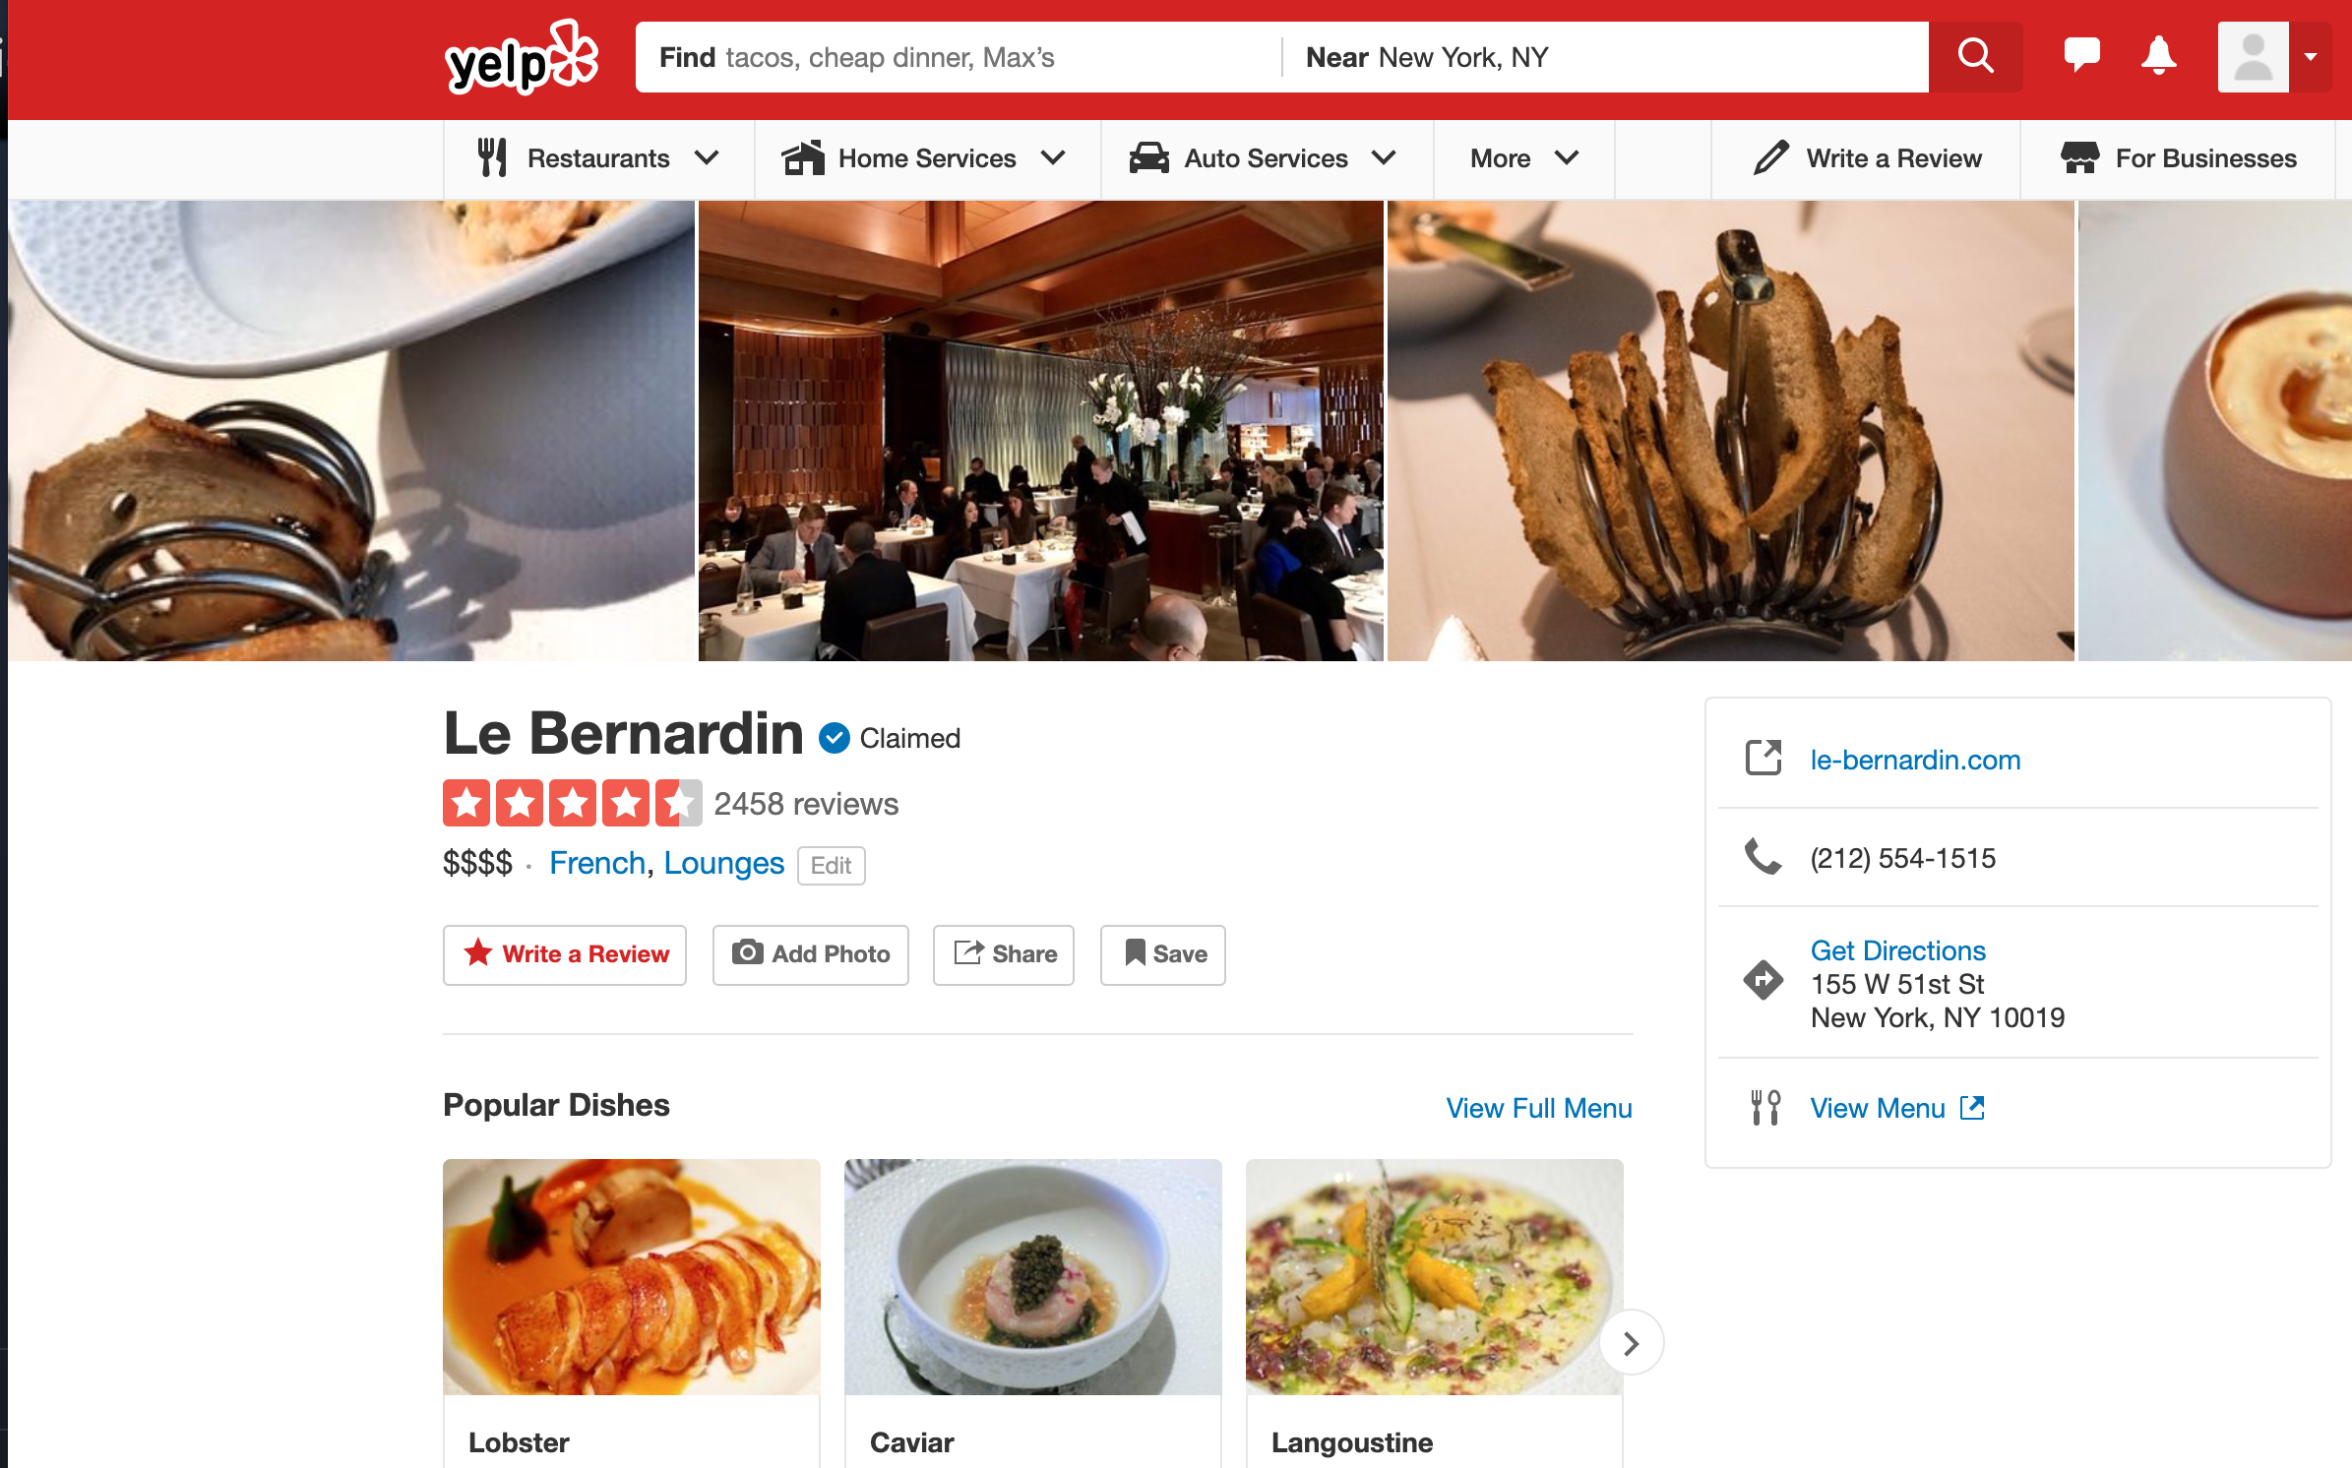
Some Samples - Tacos = Awesome
Tacos
3 Michelin Star Restaurants

Slide 5
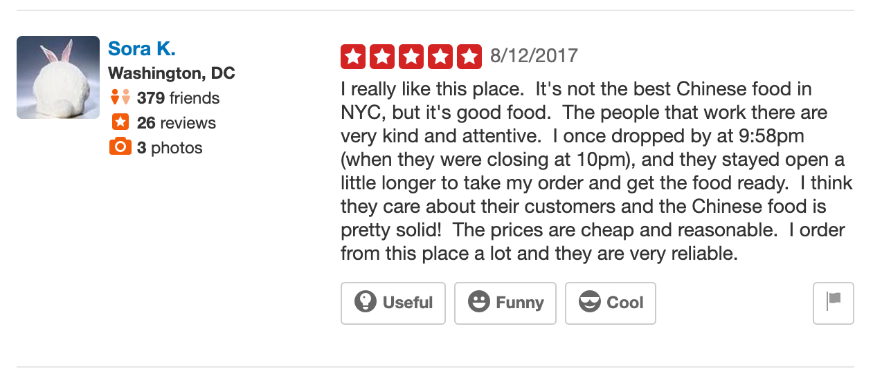
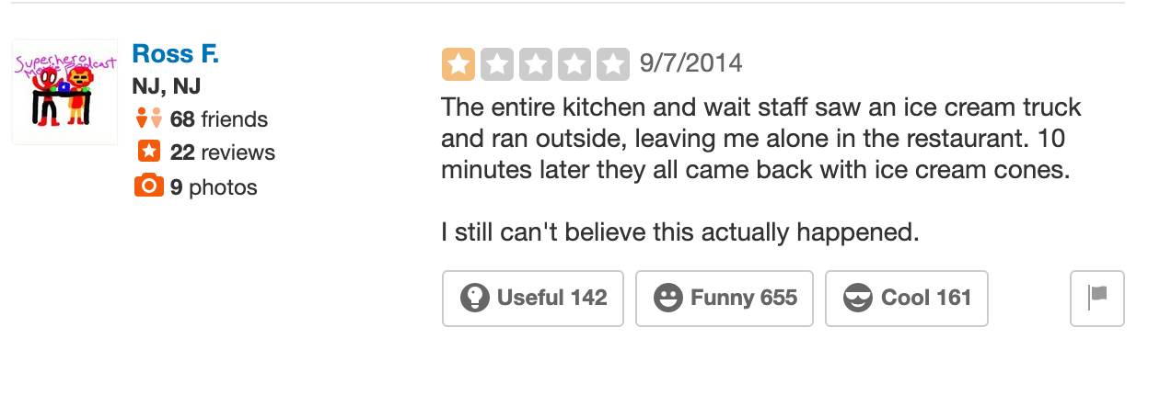
Reviews were Also Flawed
Too Much Sentiment
Not Really Sure What to Do With This

Slide 6
That Restaurant: Yeah or Nah?

Slide 7
Our Data
Scraped for Days from Yelp
API: 2000 Calls for Restaurants in the NYC Area
WebScraping: 20 reviews for each restaurant in the API.
Post Cleaning:
1625 Restaurants
32,500 Reviews

Slide 8
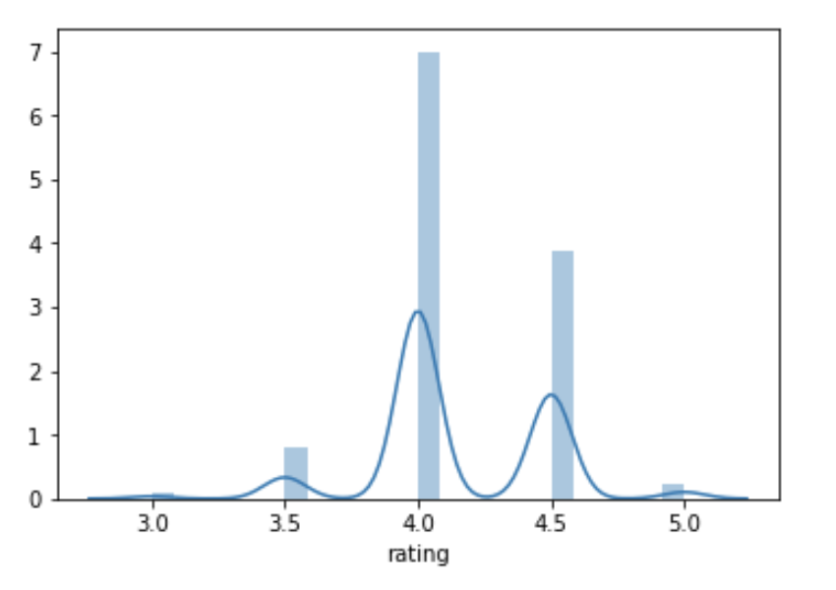
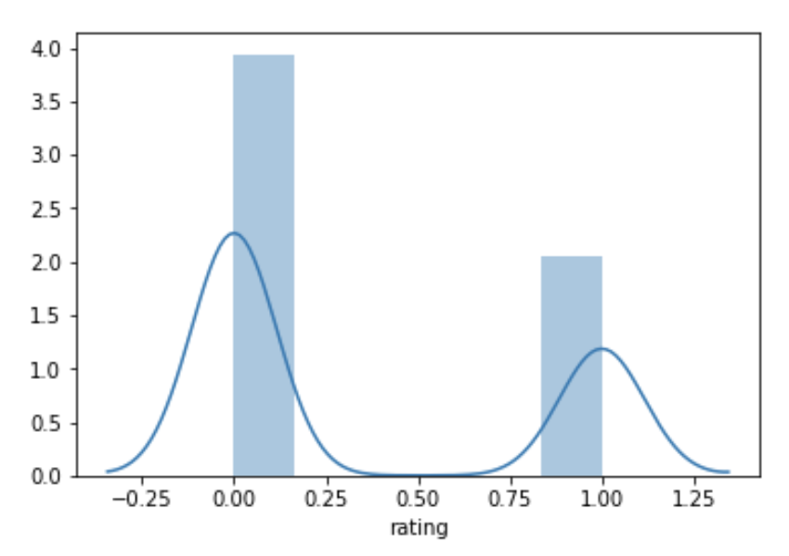
WhAT did we get from the data
The 4-star rating dominates the majority of our restaurants.
This leaves with a class imbalance that we resolved by transforming rating into a binary variables
All restaurants with review 4.5+ are classified 1: Good review (35%)
The rest under 0: Bad review (65%)

Slide 9
What did we do to our data
Drop Null values for ratings
Remove restaurant with fewer reviews
Transforming restaurant price for incorporation in models
Getting sentiment scores from reviews - 97,500 individual scores
We did not remove any punctuation, any emojis, lowercase any words, or tokenize words.
They would adversely affect the sentiment scores given by VADER

Slide 10
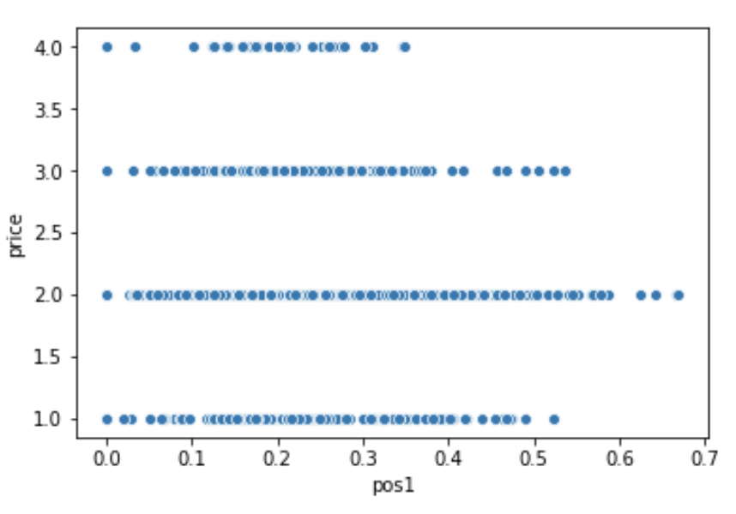
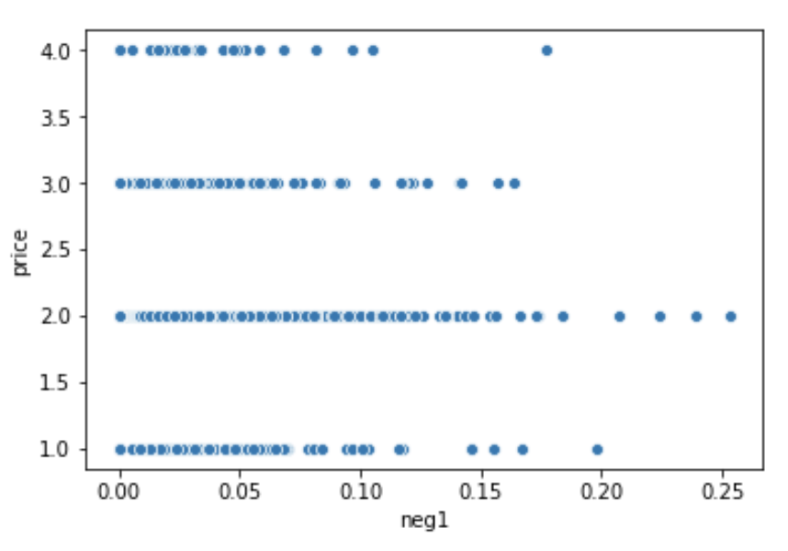
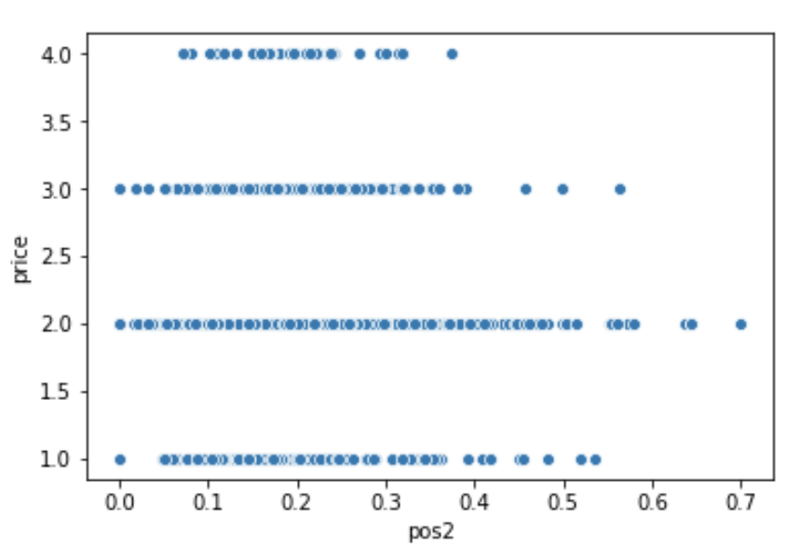
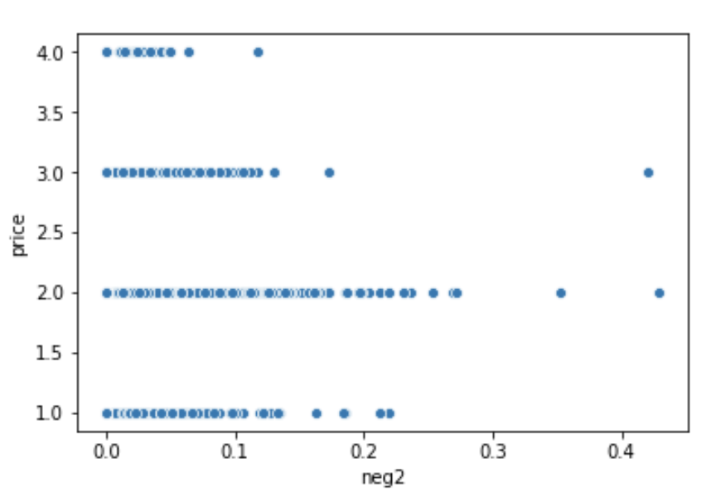
HOW THE SENTIMENTS INTERACT WITH PRICE

Slide 11
Let’s find the bad ratings

Slide 12
WHAT ARE THE MODELS USED
We are looking to predict the if a restaurant is Good or Bad based on the sentiments of the reviews
We don’t want to forecast a good restaurant and find out it’s bad - Type I error not acceptable
We want to find a model better than the baseline (Dummy: 52.3% accuracy)
 | TRAINING | TESTING
MODEL | Parameters | Accuracy | F1 Score
Naive Bayes | Gaussian/Bernoulli | 58% / 52% | 59%/54%
KNN | n=2 ; Tuning using GridSearch | 52% | 40%
Decision Trees | Tuning using GridSearch | 57% | 58%
Bagged Trees | n=20;Tuning using GridSearch | 64% | 63%
Random Forests | Tuning - bootstrap | 66% | 63%
XG Boost | Genetic Search | 65% | 65%
SVM | Kernel Linear; c=6 | 56% | 57%

Slide 13
WHAT ARE THE TAKE AWAY
Random Forest and XGBoost predicted our testing sample accurately at 66% and 65% resp.
Adding the prices of the restaurant didn’t make a significant change in the models
Due to distance between each sentiment of each review - weak learners were better predictors.
More data needed to increase prediction; topic of reviews worth analyzing separately

